Slide 1
CAR ACCIDENTS
UK / 2005-2015
Layan Balbisi - Power BI

Slide 2
Introduction
Dataset about car accidents in UK in period of 2005-2015 were used in this project.
Data preprocessing were applied
Dashboard were designed using this data , utilizing Power BI
Hidden insights were presented

Slide 3
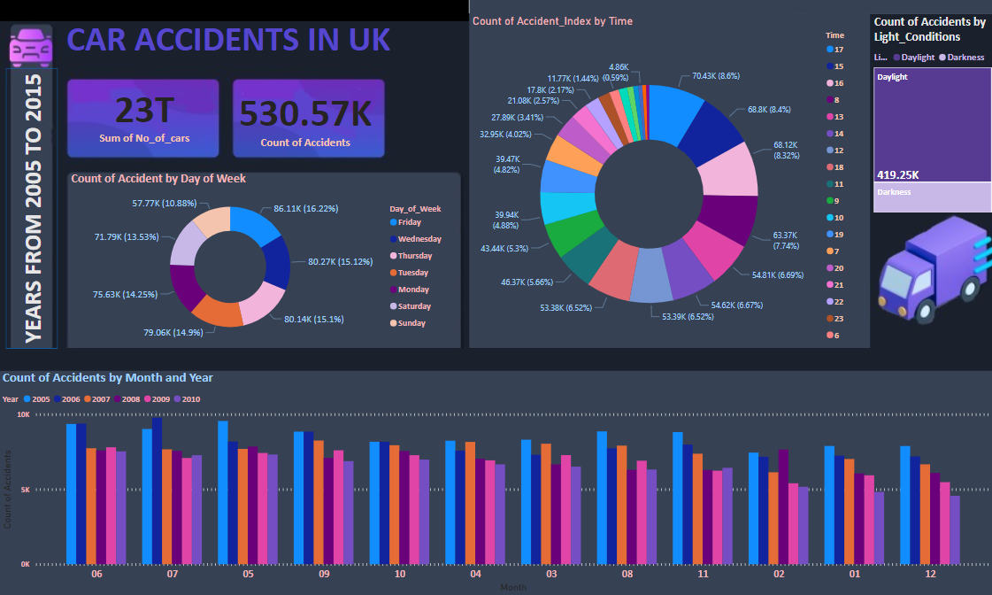

Slide 4
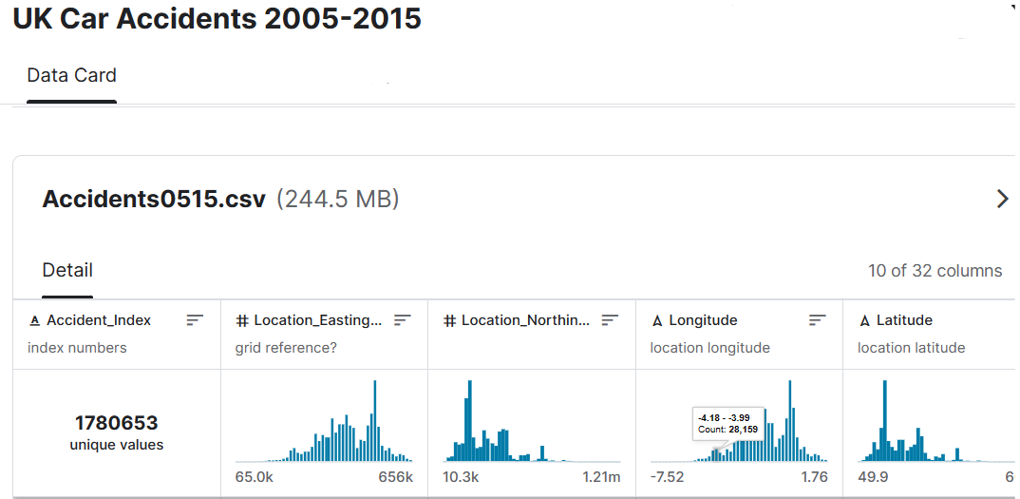
Data choosing
The dataset were selected from Kaggle,
consisting of 32 features that describe
the accidents in the UK.

Slide 5
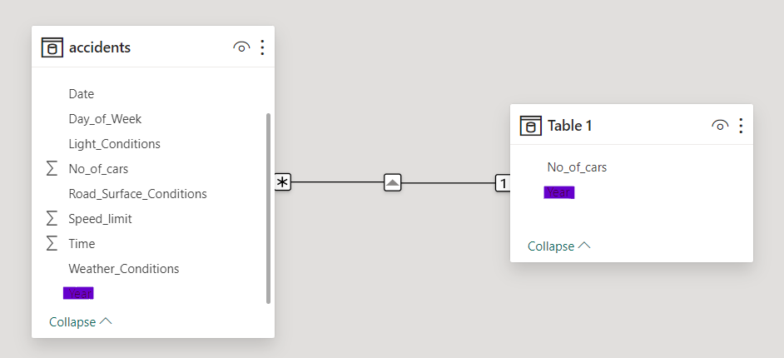
Data preprocessing
Feature selection were applied , to choose 11 feature from the 32 , depending in how useful they are to the study.
Then the dataset were merged with other dataset from the web that mentions the number of cars in UK during that period .

Slide 6
Preprocessing
Beside the feature selection , these steps were also applied:
Replace the values naming in some feature , to make them clearer to understand.
Extract the month from the date feature
Extract The Hour from the time feature
Drop the null record in each feature , I did not choose to replace them because there count were not huge , and the data size is large

Slide 7
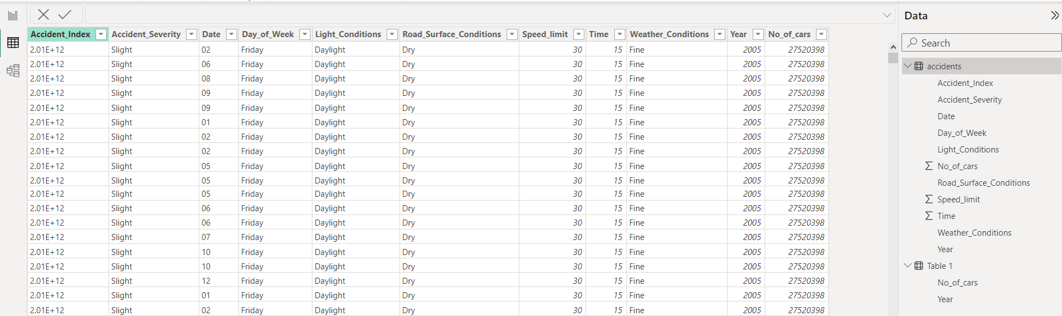

Slide 8
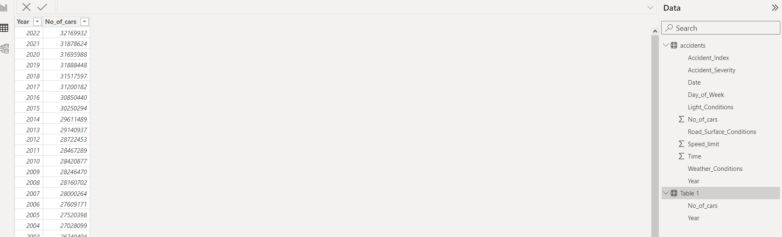

Slide 9
Hidden Insights
All these insights were observed from the charts in the dashboard.
Friday as a day , has the highest proportions of the accidents , the reason might be that Friday is the day before the weekend in UK , most people leaving there works , tired from the rest of the week .
Also, At Hour 5:00pm , has high p proportions of the accidents , it might be because it’s the average hour of leaving work /schools…etc.
More accidents happen in daylight rather than darkness , probably because there is more traffic in this period of the day.

Slide 10
Thank You
Layan Balbisi | 0215423
Business Intelligence
Power BI
Prof. Dima Suleiman

